Slide 1
Motorcycle Accident Detection Application for Android Smartphones
Carl Patrick Agbisit
Rafael Bacus

Slide 2
Rationale of the Study
Increased percentage of motorcycle accidents from 51% (2Q 2012) to 59% (1Q 2013)
54% of total people involved in vehicular accidents are ages 20 to 44
Ages 25 to 34 have highest smartphone penetration at 81%
Smartphones becoming increasingly sophisticated
Android OS, leading mobile operating system (53%)
Utilizing sensor capabilities of smartphone & open-source Android OS to develop accident detection application.
Primary concern is to notify immediate contacts of person involved in accident

Slide 3
Statement of the Problem
This study has aimed to design an application on smartphones using the Android operating system as a post-vehicular accident detection system.
The specific objectives of this research were to:
Determine the different scenarios of motorcycle accidents
Implement existing algorithms to detect changes in forces applied to the smartphone and its orientation
Develop motorcycle accident detection application
Test and Evaluate application

Slide 4
Significance of the Study
This research will benefit:
Motorcyclists - Deliver messages even if unconscious or seriously injured
Youth Demographic – Majority of motorcycle accidents occur with people mid- 20s to early 30s; most smartphone users around the same age
Close Relations – Family and friends not “left in the dark”
Computing Field – Base application made available for future improvements

Slide 5
Scope and Limitation
Scope
Android Operating System
Motorcyclists
GPS
Data Plan
Limitation
Older Android OS Versions (Before v4.0 “Ice Cream Sandwich”)
Smartphone rendered incapable of use during impact
No motorcycle testing

Slide 6
Test Environment

Slide 7
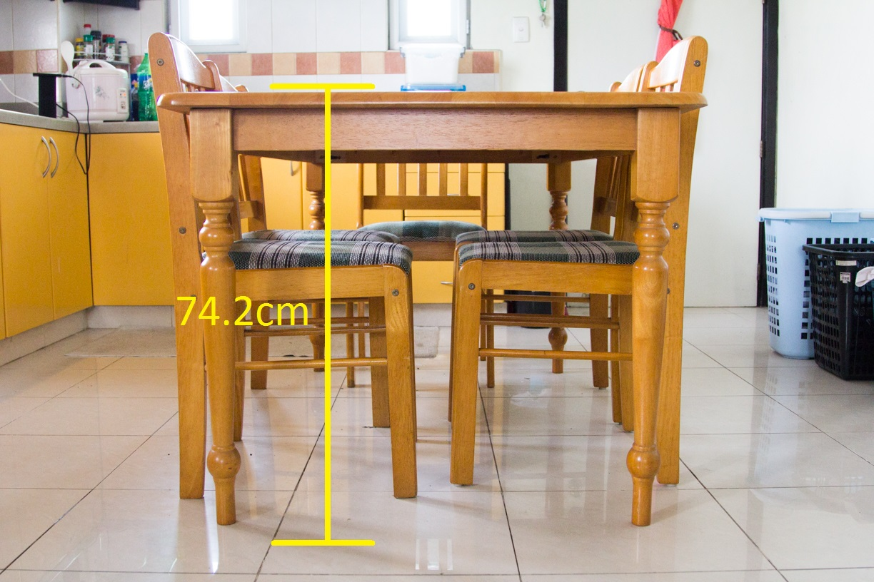
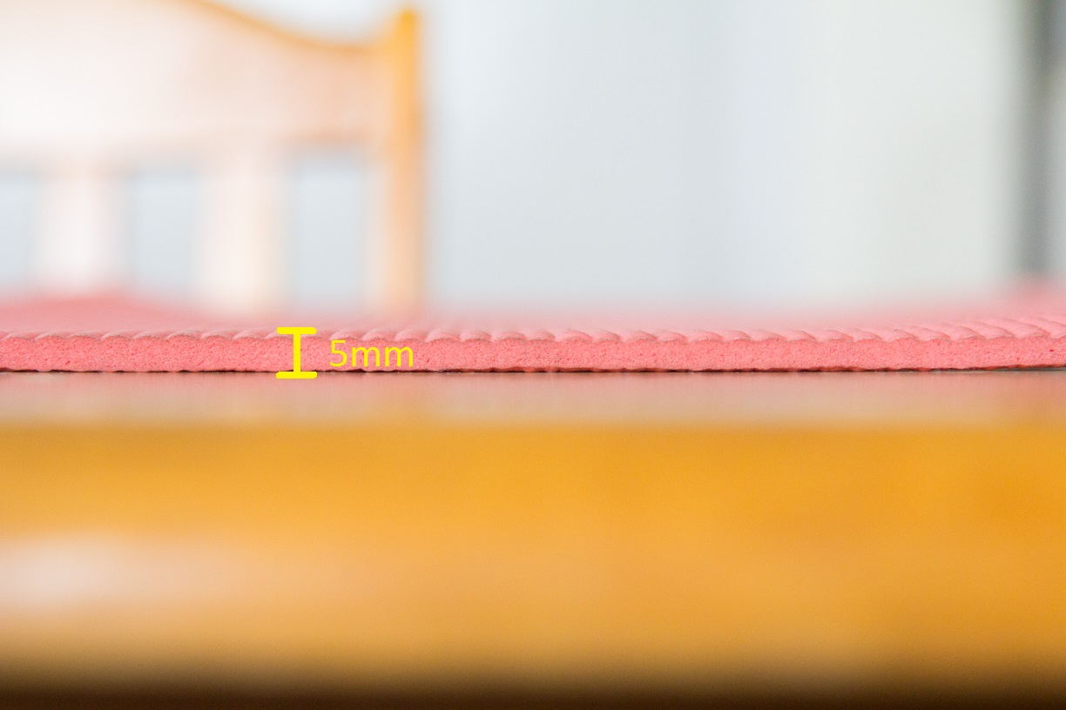
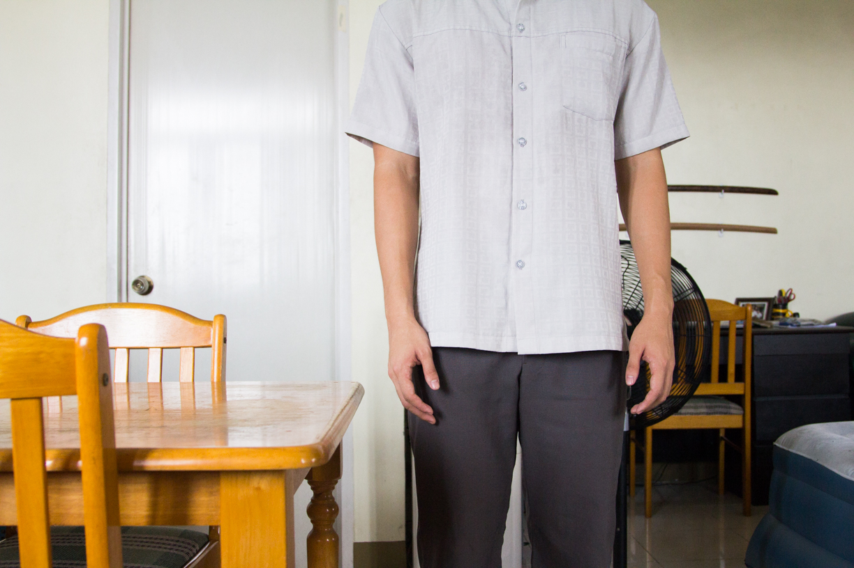
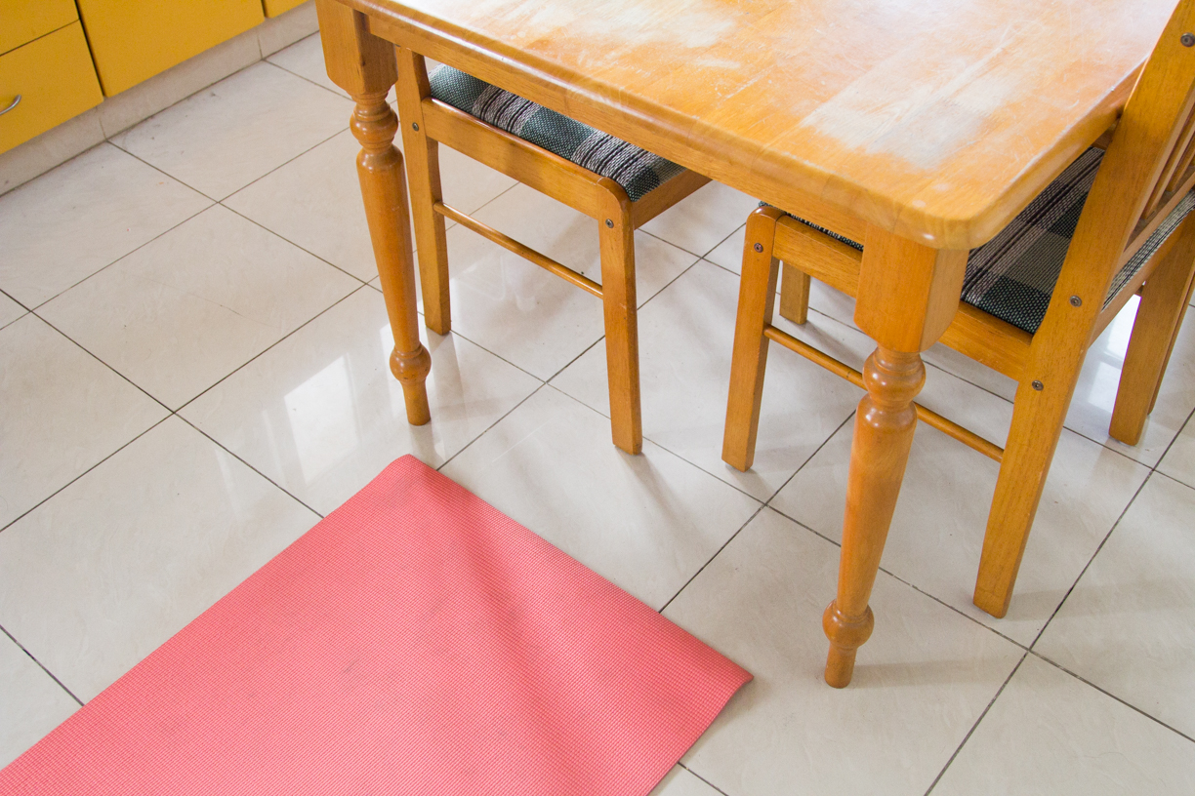
Area

Slide 8
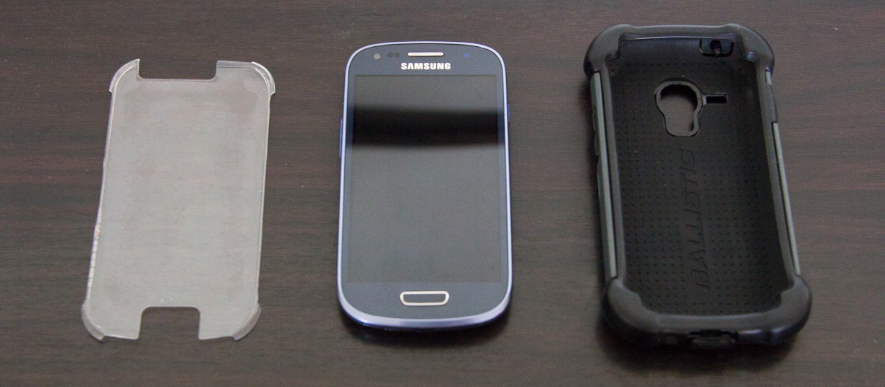
Samsung Galaxy S3 Mini SM-G370A Ballistic Hard Case

Slide 9
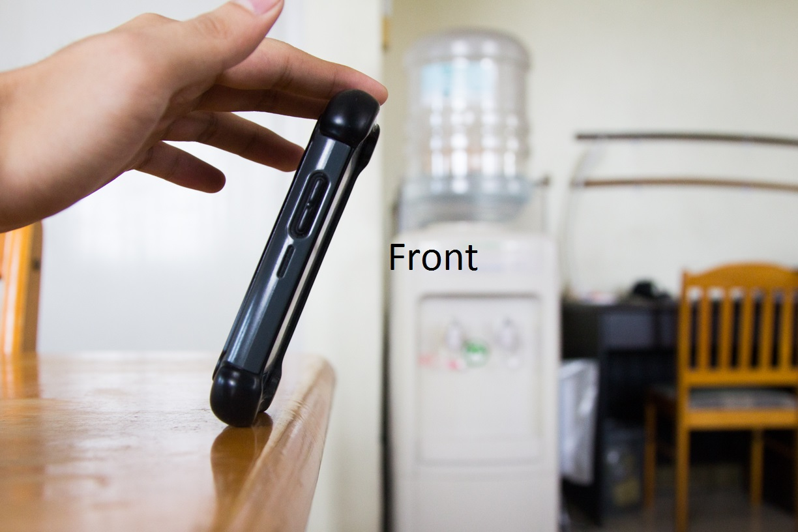
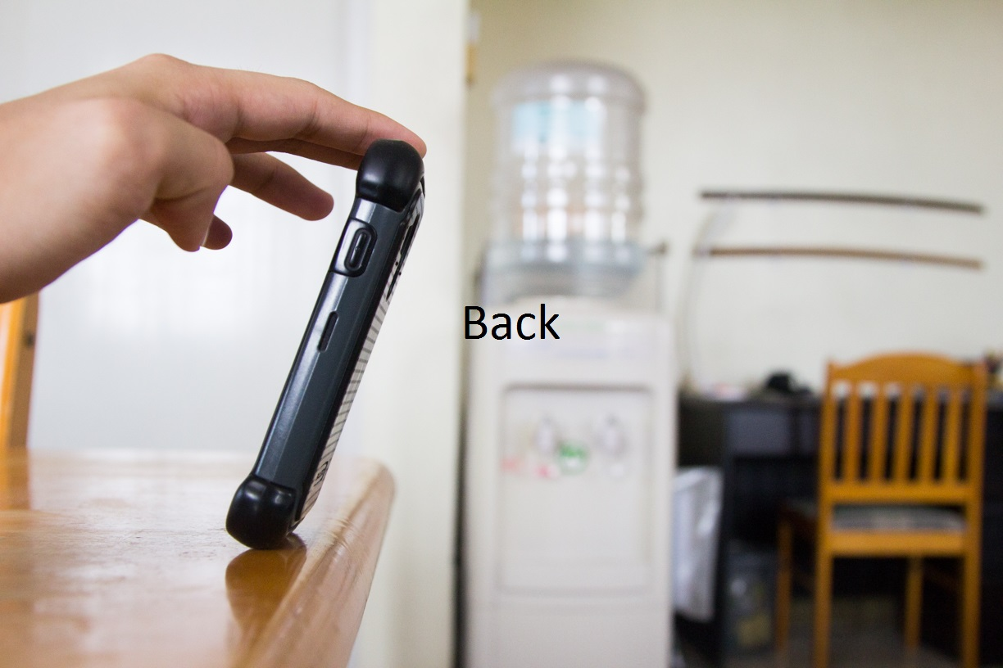
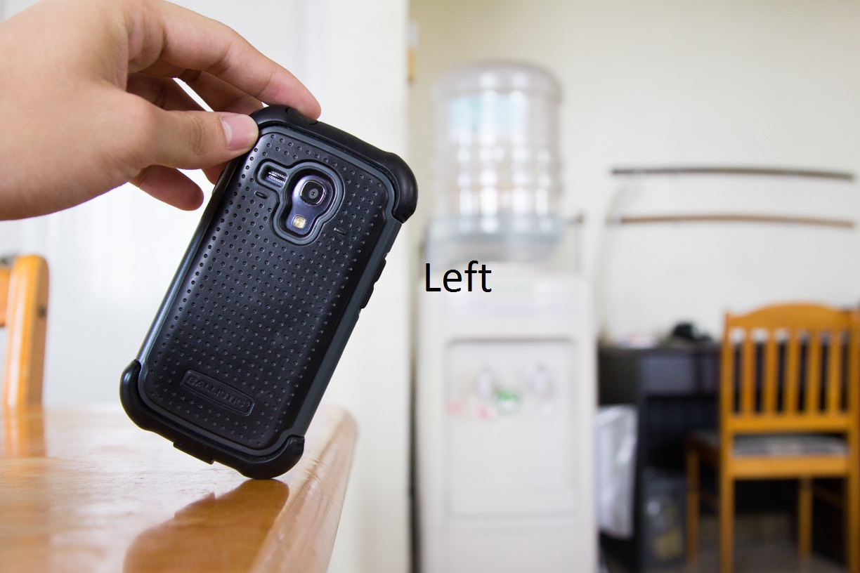
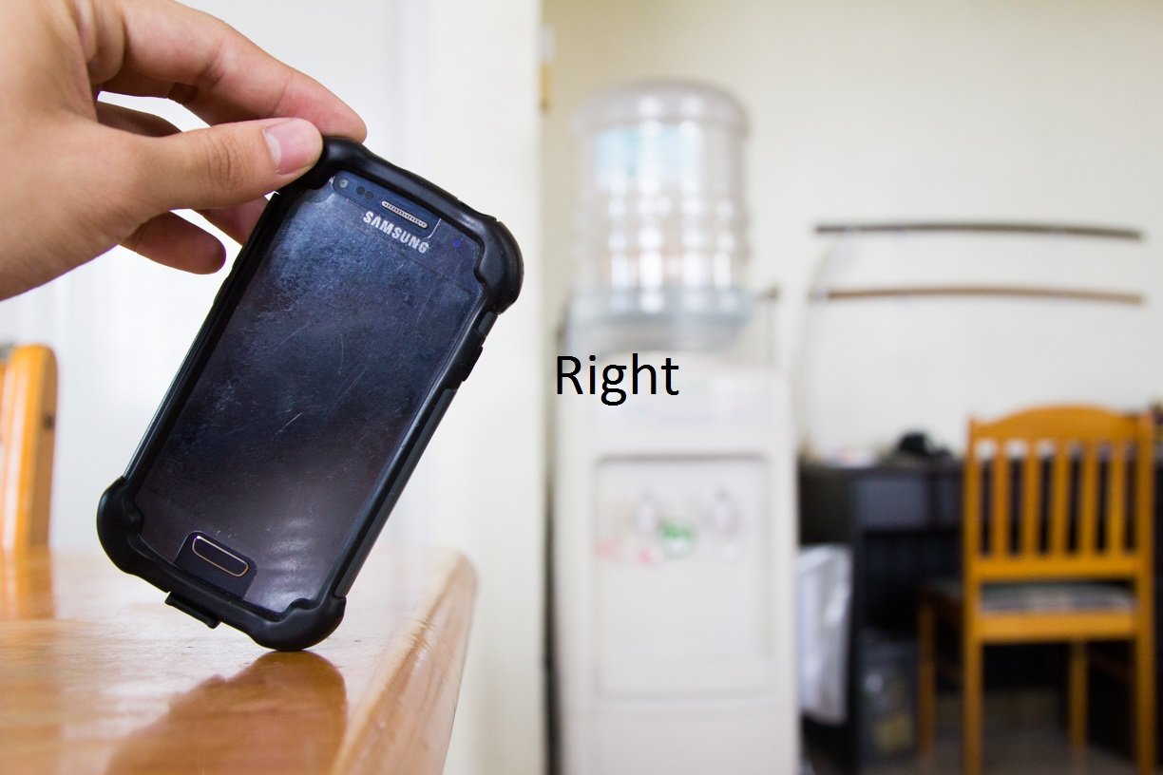
4 Orientations
Front
Back
Left
Right
5 trials each

Slide 10
Objectives & Results

Slide 11
Determine the different scenarios of motorcycle accidents
The Royal Society for the Prevention of Accidents (RoSPA)
MotorcycleAccident.org
RidersPlus
RideApart
Bends, junctions, overtaking, and loss of control
Motorcycle drives straight through intersection as vehicle makes left turn on opposite side of intersection
Entering curve at too high speeds
Road conditions unsafe
Rear-ending & cars overtaking motorcycle
Notes:
Objective 1
1. None
2. Fail to see narrow profile of motorcycle
Motorcycle going at top speeds
3. Motorcycle less maneuverable
4. Rain, leaves, gravel

Slide 12
Implement existing algorithms to detect changes in forces applied to the smartphone and its orientation
Kangas et al. threshold algorithm
Detect if device is falling
Built-in tri-axial accelerometer
Calculate sum vector using values from each axis
Calculate if impact has occurred
If sudden spike in sum vector calculations
Detect change in posture or orientation of object
Built-in gyroscope
Notes:
Objective 2
Implementation and pseudocode will be discussed during the next objective

Slide 13
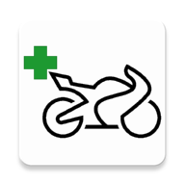
Develop motorcycle accident detection application
LifeCycle
Notes:
Objective 3

Slide 14
LifeCycle
Eclipse Juno & Luna
Target Minimum Android 4.0
Samsung Galaxy S3 Mini
Android 4.2.2
Tri-axial Accelerometer
Gyroscope
GPS Capabilities
User Data Storage
Monitoring
Location Tracking
Messaging

Slide 15
User Data Storage
Personal and medical information
Name
Blood type*
Age
Height
Weight
Medications
Conditions
Allergies
Shared Preferences
Emergency contacts
Name
Number
Personal message
SQLite Database
Notes:
Blood type – required
Medications, Conditions, Allergies default to “None”
Number defaults to “Select a number”
Personal Message defaults to generic message

Slide 16
class ContactsMenu{
onCreate(){
Populate emergency contact list
}
openPhonebook(){
If(numOfContacts < 10){
Redirect to device’s phonebook
User selects contact
Contact stored in SQLite DB
Default values:
Name, “Select a number”, generic message
} else{
Prompt max numOfContacts reached
}
}
getContactsFromDatabase(){
Create connection to SQLite DB
Create List<Contact>
Populate List with SQLite DB rows
Return List<Contact>
}
ifDuplicate(){
Checks if contact with same name exists in List<Contact>
}
isQualifiedNumber(){
Checks if length is 11 digits and contains no characters
}
onBackPressed(){
Check if(any contact still has “Select a number” set for Number field){
Prompts user to select a valid phone number for contact
} else{
Return to Main Menu
}
}
onListItemClick(){
If(Delete toggle is false){
Views contact details
} else{
Prompts to delete contact
}
}
}

Slide 17
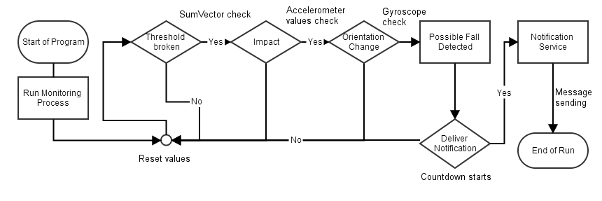
Monitoring

Slide 18
class Monitor{
onInstantiation(){
Initialize field members;
Create Dialog to display “Accident detected!”;
}
startMonitoring(){
Reset field members to default;
Start accelerometer;
}
pauseMonitoring(){
Stop accelerometer;
}
checkIfImpact(){
Check if accelerometer data has a spike in values;
}
countDown(){
Start location tracking;
Start alarm;
Start countdown timer;
}
onSensorChanged(){
Determine if accelerometer or gyroscope data;
If(accelerometer data){
Compute sum vector;
If(sum vector is below 0.6 g){
Monitor for additional 1.2 seconds
Check if impact occurred during additional 1.2 seconds
If(impact & rotation occurred){
Display “Accident detected!” dialog
Start countdown timer to send messages
} else{
Reset class field members;
}
}
} else if(gyroscope data){
Compute if rotation has occurred;
}
}
}

Slide 20
Location Tracking

Slide 21
class LocationTracker{
constructor(){
Build Google Api Client;
Set location request parameters (interval, fastest interval, priority);
Connect to Google Api Client;
}
onConnected(){
Request for location update based on location request parameters;
}
onLocationChanged(){
Remove location updates;
Disconnect from Google Api Client;
}
ifSettingsChecked(){
Checks if phone settings allow application to get location using GPS and network-based sources;
}
hasLocation(){
Checks if latitude and longitude values are set based on location retrieved from Google Api Client
}
}

Slide 22
Messaging

Slide 24
Test and Evaluate application
Notes:
Objective 4

Slide 25
Demonstration

